Slide 1

JAYPEE INSTITUTE OF INFORMATION TECHNOLOGY, SECTOR 62
MINOR PROJECT
Automated Car Parking System

Slide 2

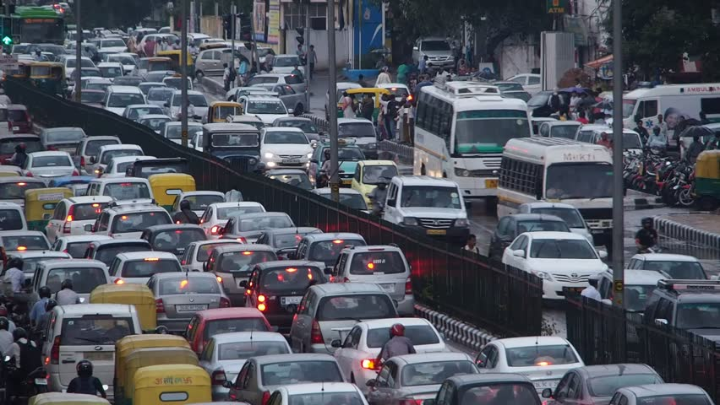
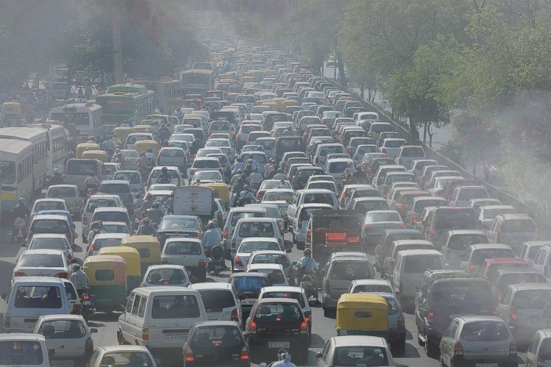

Slide 3
Need and benefits analysis of smart parking
Accurately predict and sense spot/vehicle occupancy in real-time.
Guides residents and visitors to available parking.
Optimize Parking Space Usage
Simplifies the parking experience and adds value for parking stakeholders, such as drivers and merchants
Help traffic in the city flow more freely leveraging IoT technology.
Enables intelligent decisions using data, including real–time status applications and historical analytics reports
Smart Parking plays a major role in creating better urban environment by reducing the emission of CO2 and other pollutants
Smart Parking enables better and real time monitoring and managing of available parking space ,resulting in significant revenue generation
Provides tools to optimize workforce management

Slide 4
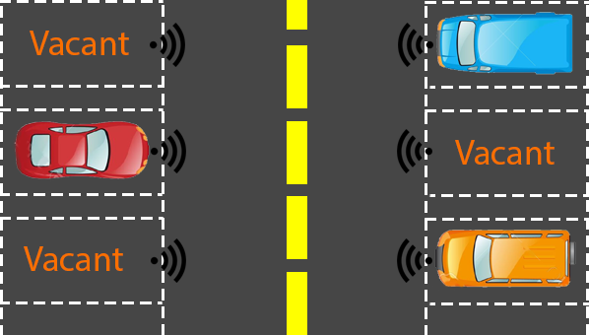

Slide 5
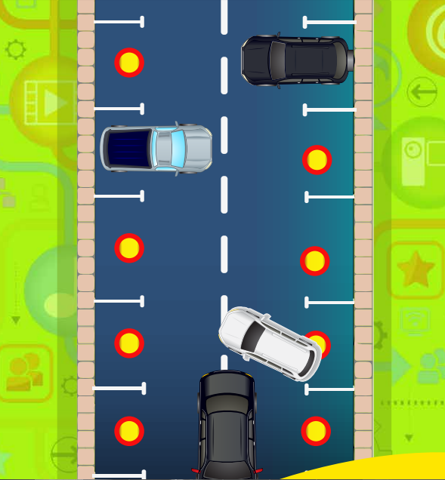

Slide 6
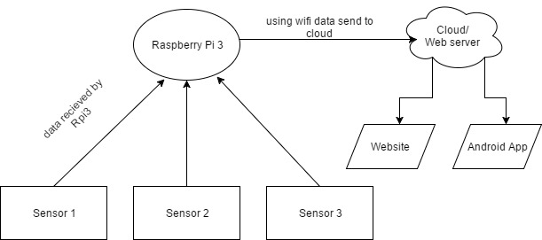
Model
ARDUINO

Slide 7
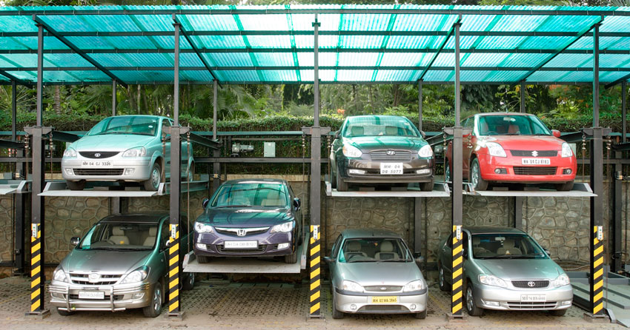

Slide 8
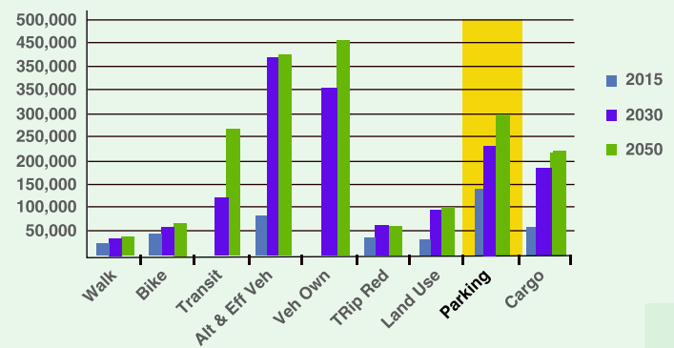
According to a report, Smart Parking could result in 2,20,000 gallons of fuels saving till 2030 and approx. 3,00,000 gallons of fuels saved by 2050 , if implemented successfully.

Slide 9


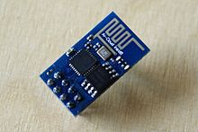
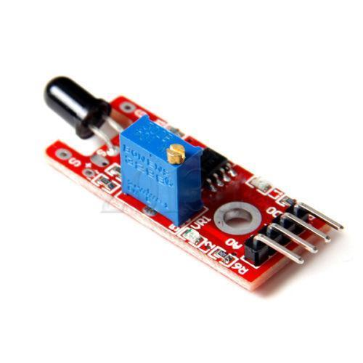
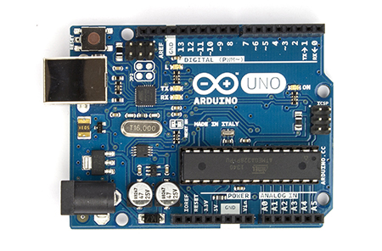
Components
1.) Arduino UNO
2.)IR Sensor
3.)ESP8266-01

Slide 10
Software Required
Arduino IDE
Web Server
Any Browser

Slide 11
Advantages
1.)Real Time Monitoring
2.)User Friendly
3.)Reduce Traffic
4.)Up to Date

Slide 12
Further Work
1.)Slot Booking System – User allotted with a fixed time.
2.)Automatic navigation System.
3.)Can be extended to a company parking system giving the best slot for parking a particular vehicle.

Slide 13
End Products/Conclusion
1.)A model visualizing parking slots.
2.)An android app displaying related information.

